Slide 1

MOVIE RECOMMENDATION SYSTEM
PASUPULETI SRIHITHA
100805018

Slide 2
BUSINESS PROBLEM
Recommending movies to the users based on his tastes, ratings or the movies he/she watched .

Slide 3

DataSources :
https://www.kaggle.com/tmdb/tmdb-movie-metadata

Slide 4
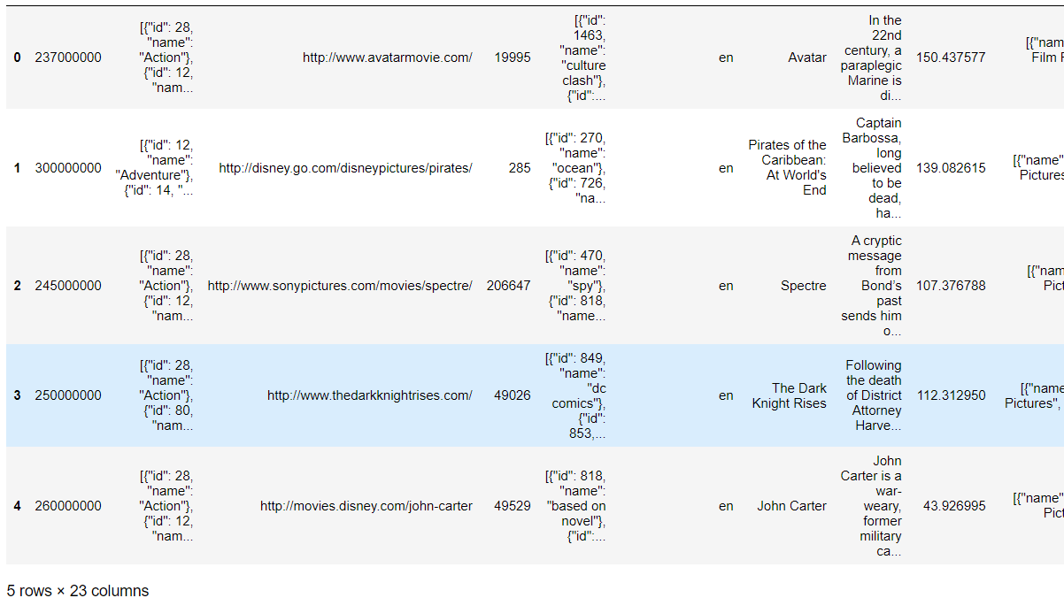
DataSet

Slide 5
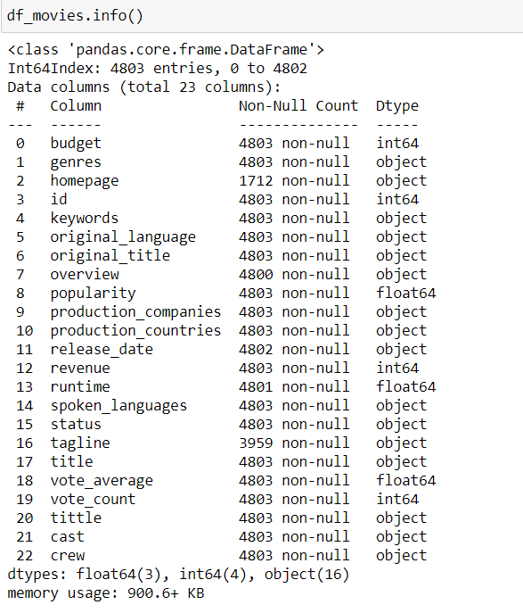
This gives the information about all the columns in dataframe

Slide 6

EXPLORATORY DATA ANALYSIS

Slide 7
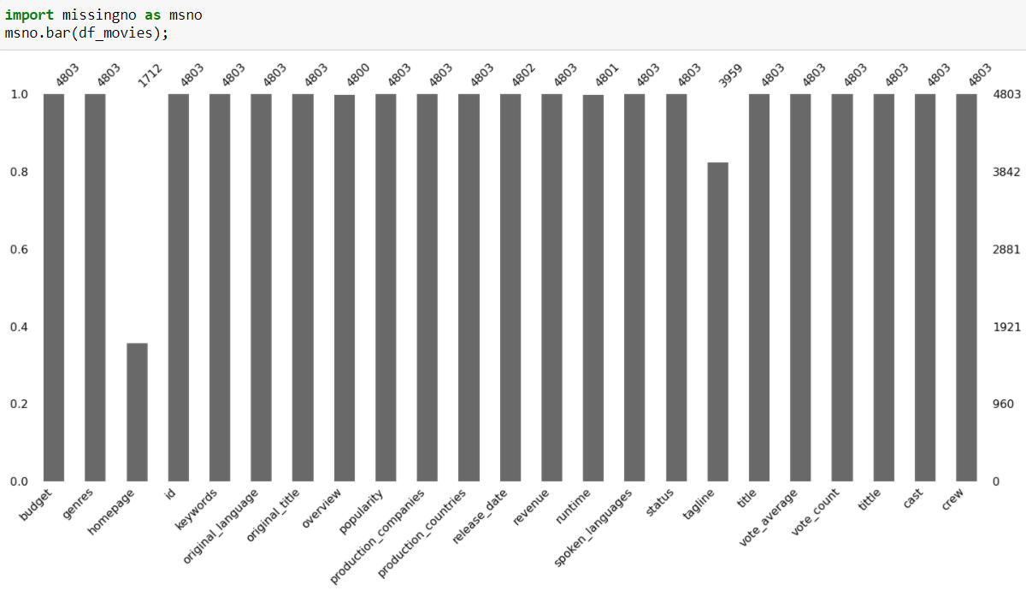
This graph tell about the missing values of all the columns in dataframe

Slide 8
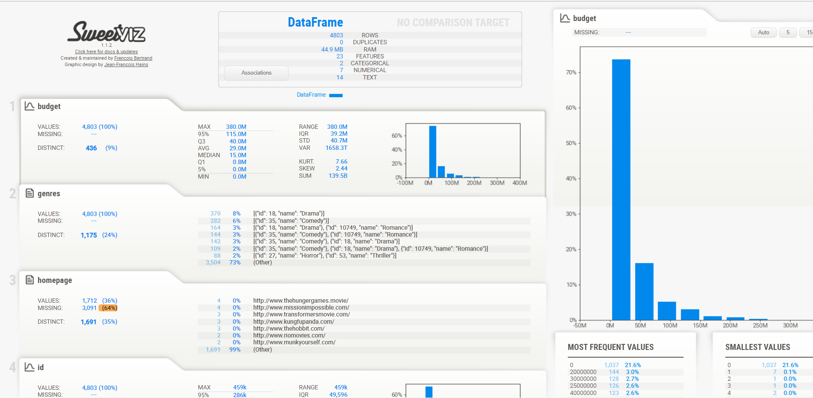
This graph gives information about each column in dataframe

Slide 9
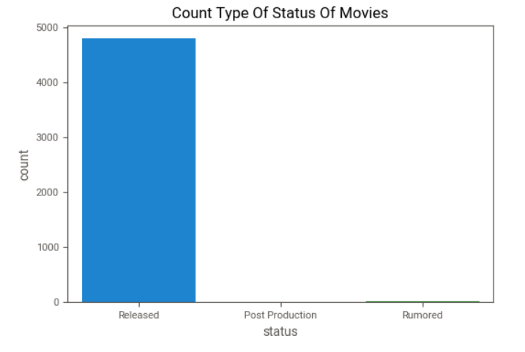
What are the different types of status of Movies ??
It can be seen that most of the movies are released and very few movies are rumored

Slide 10
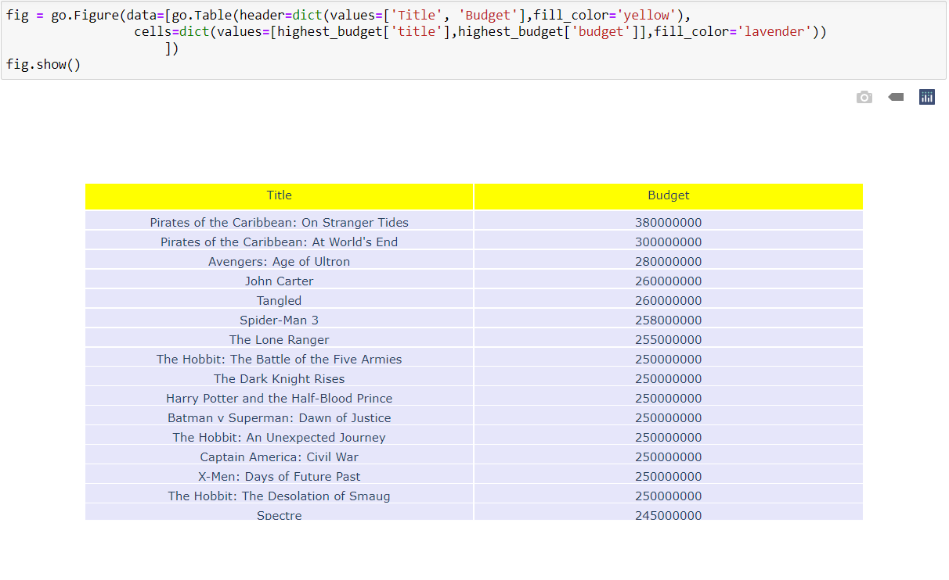
Which Movies have the highest budget ??

Slide 11
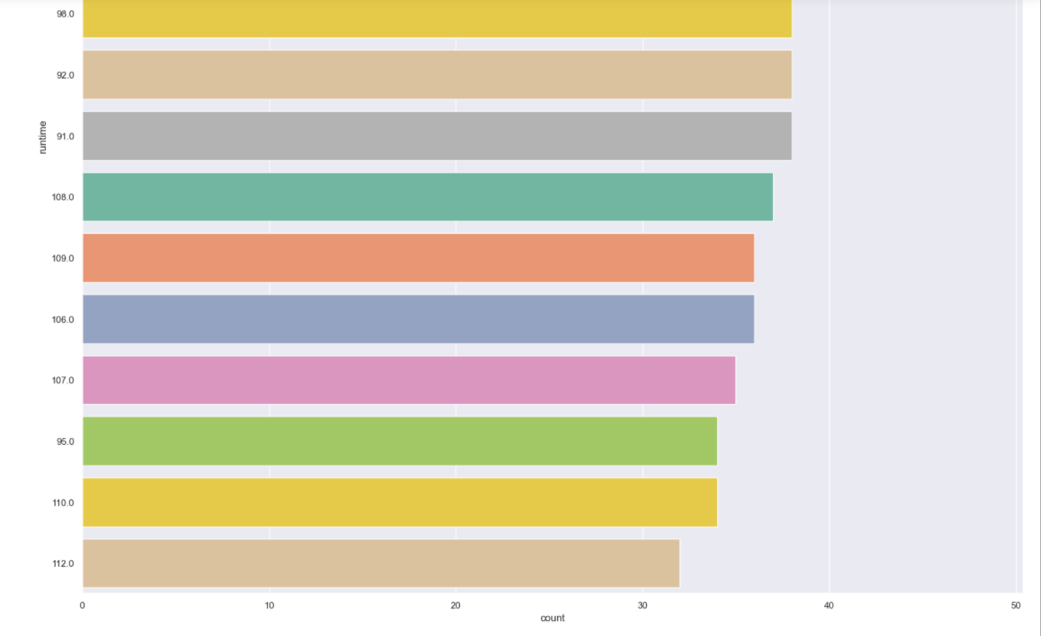
What is the runtime of Moviess ???

Slide 12
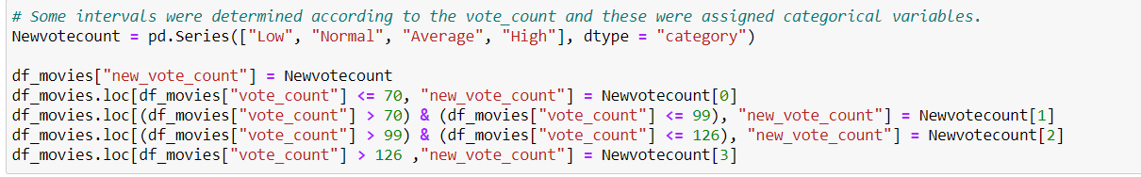
FEATURE ENGINEERING
Some intervals were assigned depends on votecount and given values

Slide 13
ONE HOT ENCODING
Converts the categorical data into dummy variables

Slide 14
FILTERING TECHNIQUES
Content Based Filtering :
In this recommender system the content of the movie (overview, cast, crew, keyword, tagline etc) is used to find its similarity with other movies. Then the movies that are most likely to be similar are recommended.
Collaborative Filtering :
Our content based engine suffers from some severe limitations. It is only capable of suggesting movies which are close to a certain movie. That is, it is not capable of capturing tastes and providing recommendations across genres.

Slide 15
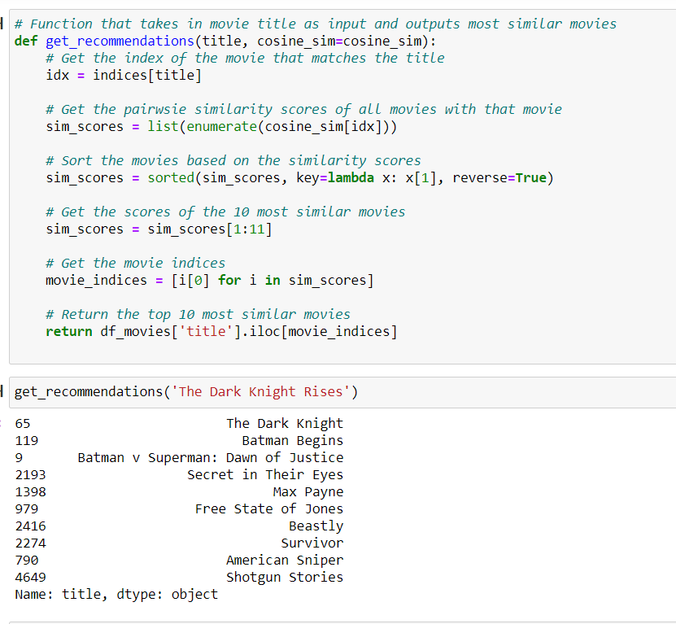
CONTENT BASED FILTERING

Slide 16
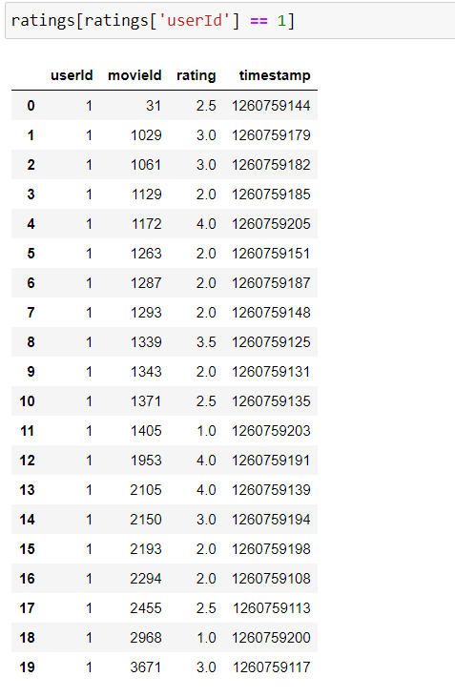
COLLABORATIVE FILTERING

Slide 17
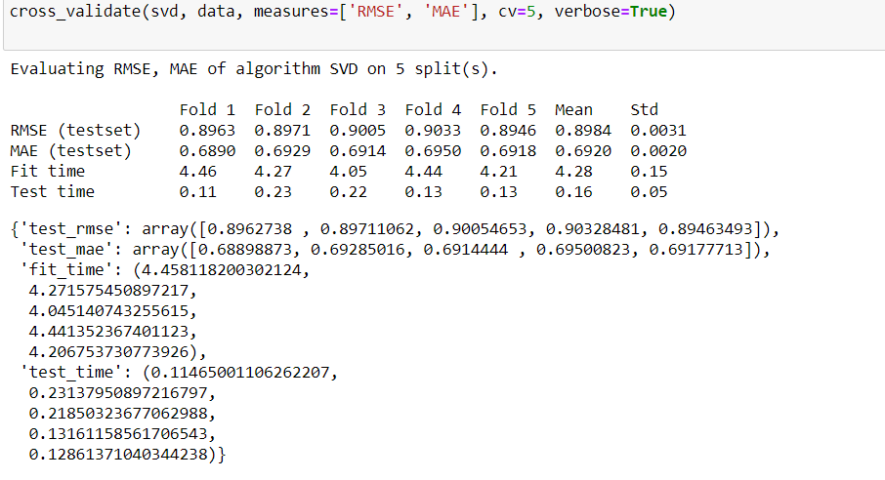
EVALUATION

Slide 18
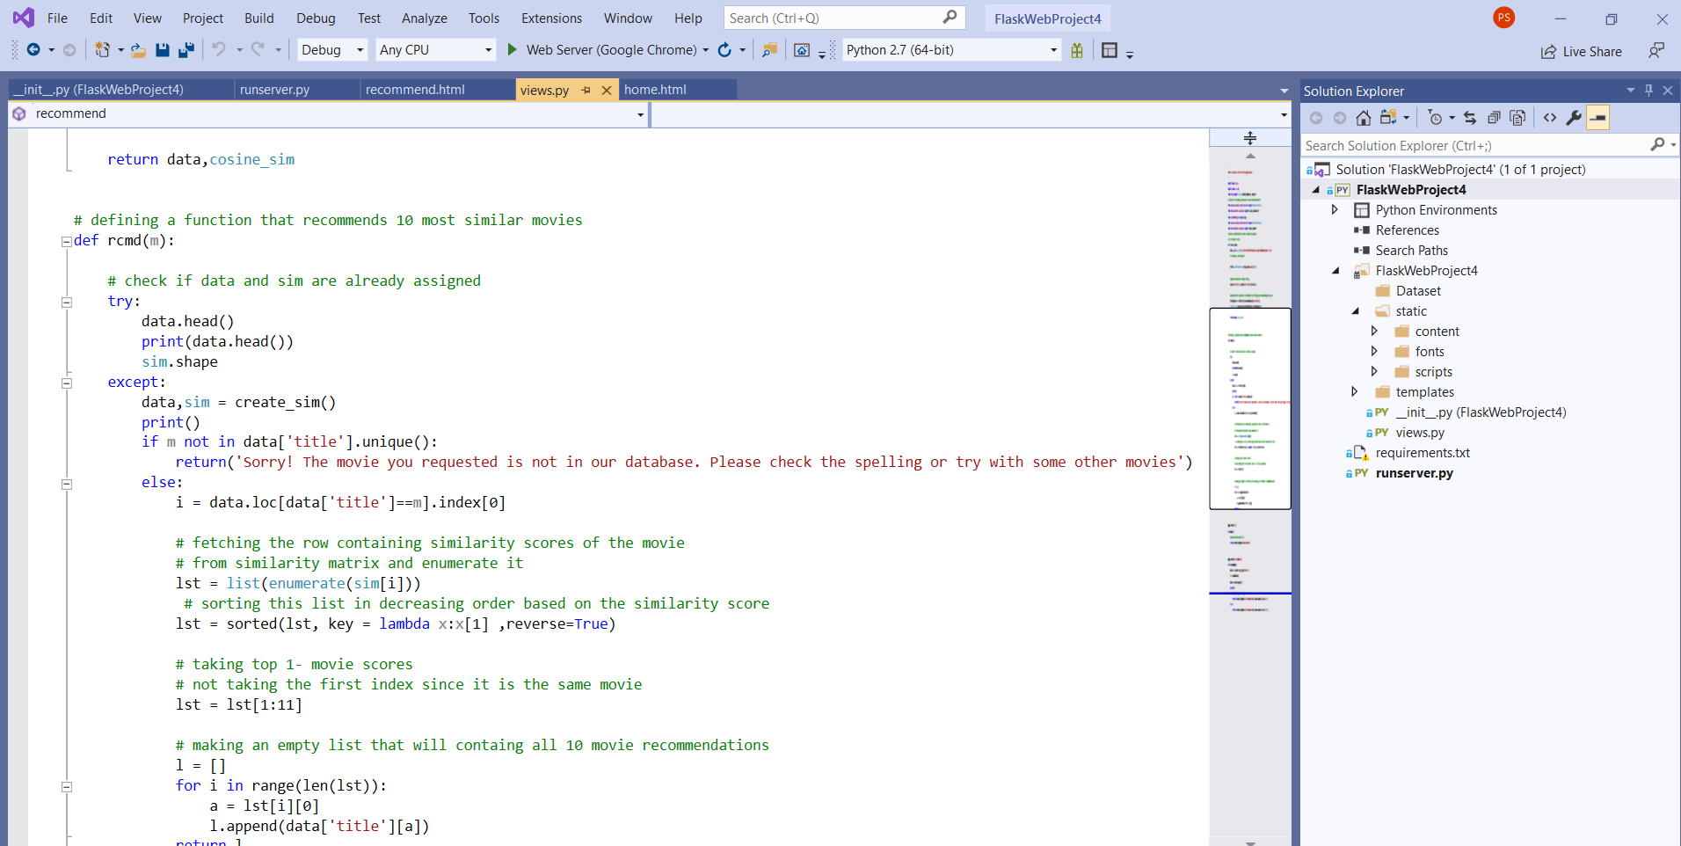
Main.py

Slide 19
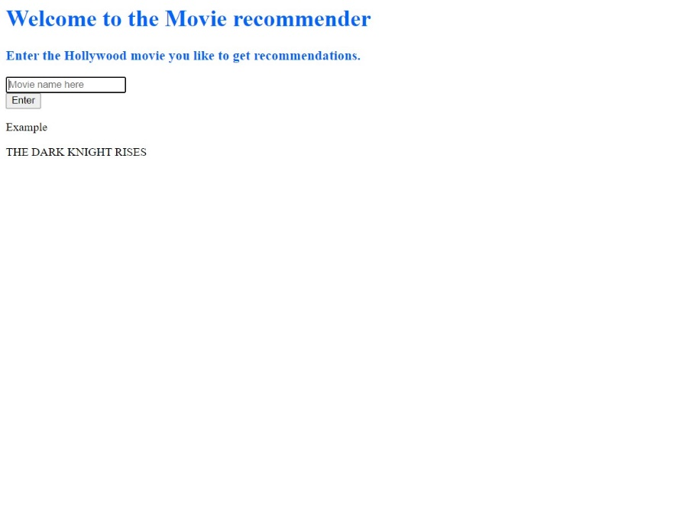
WEB APP

Slide 20
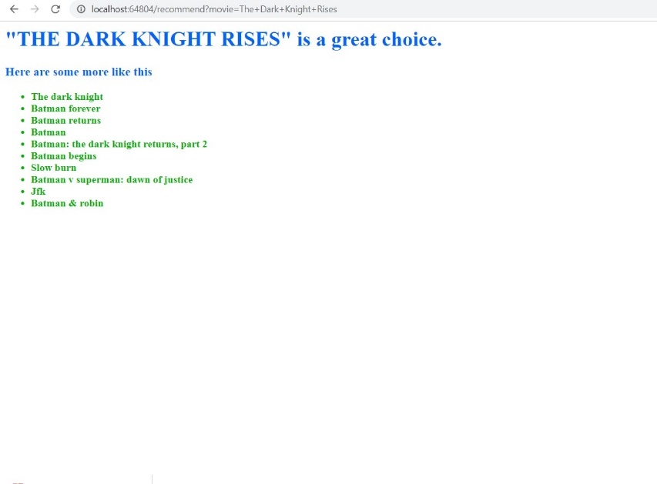
Recommending the movies based on given movie

Slide 21
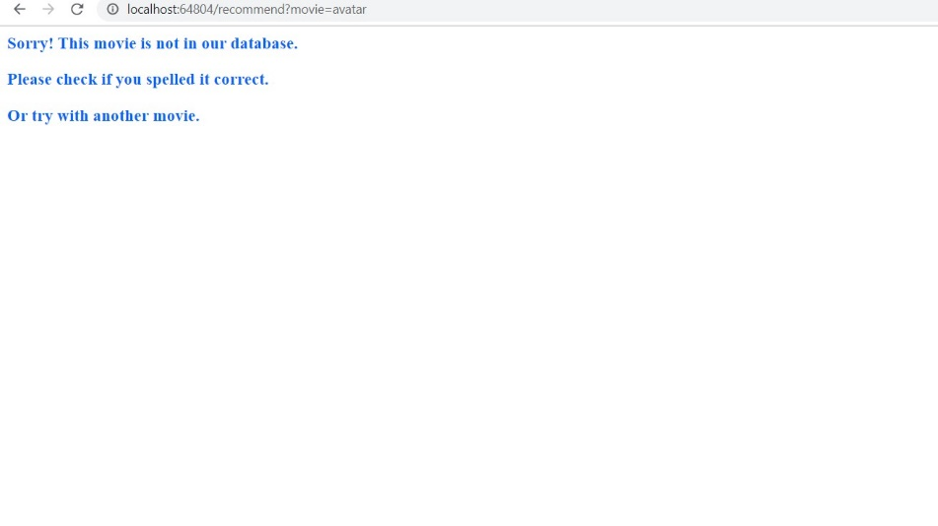
When the requested movie is not in database

Slide 22
CONCLUSION
Hybrid Systems can take advantage of content-based and collaborative filtering as the two approaches are proved to be almost complimentary.

Slide 23
THANK YOU

